Slide 1
Data Security
Module 2: 09

Slide 2
Objectives
SQL Injection
Hashing
Salting
Hashing Passwords
Encryption
Data at Rest with Symmetric Encryption
Data in Transit with Asymmetric Encryption
Man In the Middle Attack

Slide 3
SQL Injection
“SELECT * FROM app_user WHERE UPPER(user_name) = '" +userName.toUpperCase() + "' "+ "AND password = '" + password + "'"
What if I enter a valid username (Bill) and then the password as: ‘ OR 1=1--
SELECT * FROM app_user WHERE UPPER(user_name) = 'BILL’ AND password = '’ OR 1=1--'
What is the result of this query?
It returns the row of data were user_name = “Bill” regardless of the password, because OR 1=1 is always TRUE.
The trailing -- changes the remainder of the SQL statement into a comment, ending the query after OR 1=1.

Slide 4
Types of SQL Injection
Query Modification
The attacker modifies the original query and then Ignores the rest of the original by adding -- at the end of their addition to comment it out.
Union Attack
The attacker creates a UNION with an existing query that returns results from their query mixed with results of a legitimate query.
Stacked Queries
The attacker ends the original query with a ; and then appends their own query onto the original..

Slide 5
Preventing SQL Injection
Parameterized Queries - The single most effective thing you can do to prevent SQL injection is to use parameterized queries. If this is done consistently, SQL injection will not be possible.
Input Validation - Limiting the data that can be input by a user can certainly be helpful in preventing SQL Injection, but is by no means an effective prevention by itself.
Limit Database User Privileges - A web application should always use a database user to connect to the database that has as few permissions as necessary.

Slide 6

SQL Injection/Security Resources
OWASP (Open Web Security Project) - SQL Injection
Hacksplaining
Past Student suggested Video on SQL Injection

Slide 7
Hashing
A Hash Function is one that can map input data of arbitrary size to a fixed size output.
Hashing is 1-way, meaning that once data is hashed, the hash cannot be reversed back into the original data.
Commonly used to store passwords.
MD5 Hash Generator

Slide 8
Salting
A Salt is a fixed-length cryptographically-strong random value that is added to a password as input to a hash function.
Dictionary attacks make passwords hashed with common algorithms vulnerable, salting reduces the effectiveness of dictionary attacks by making all input values for passwords unique.

Slide 9
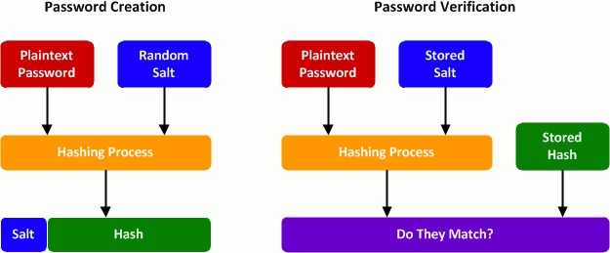
Password Salting

Slide 10
Encryption
Encryption is the most effective way to achieve data security. When data is sent between two parties or stored, it is stored in an encrypted non-human readable format that requires the key to properly decrypt and understand.
OWASP Guide to Cryptography

Slide 11
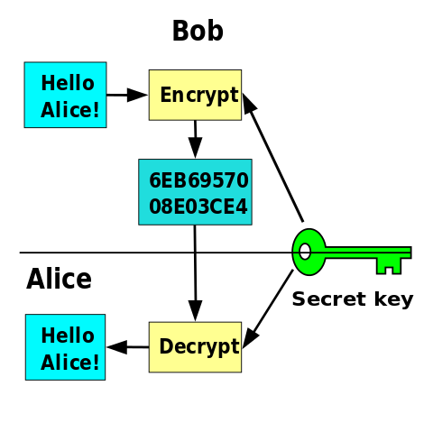
Encrypting Data at Rest
Data at rest can use a form of encryption called symmetric key encryption
Requires both parties to use the key to encrypt and decrypt data.
Any party possessing the key can read the data.
Has difficulties securing the symmetric key amongst multiple parties.
Symmetric cryptography involves the parties sharing a common secret passphrase or key. Data is encrypted and decrypted using the same key.

Slide 12
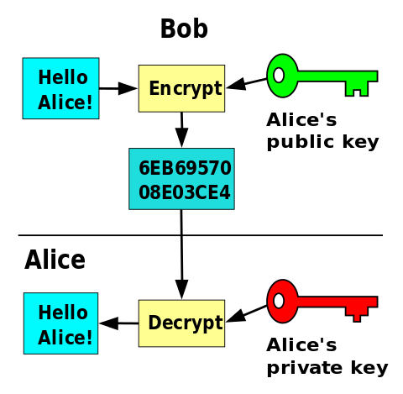
Securing Data in Transit
Data in transit can use a form of encryption called asymmetric key encryption
Uses a Private and Public Key
Any party can be sent the public key. It can encrypt the data, but not decrypt it.
Only the key owner has the private key. It can decrypt data encrypted by the public key.
Has difficulties securing the symmetric key amongst multiple parties.
Asymmetric cryptography uses two keys: one to encrypt the data and the other to decrypt.

Slide 13
Asymmetric Encryption Common Usages
Communication/Network Security: Digital Certificates
Normally a paid subscription
OpenSSL - Open Source / Free Certificates
http:// (insecure) vs https:// (secure)
Web: HTTPS (SSL (Secure Socket Layer) /TLS (Transport Layer Security) )
HTTPS Everywhere Project - movement to make all communication on the internet encrypted using OpenSSL
Java: Bouncy Castle
open source library that provides asymmetric encryption for Java

Slide 14
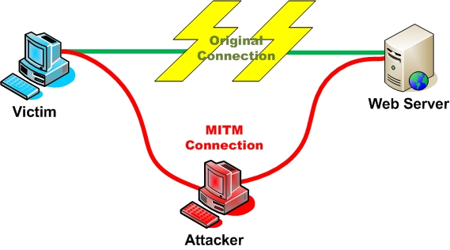
Man In the Middle Attack
Performed by a local malicious network connection, for example, in a coffee shop or hotel.
Attacker provides a fake wifi connection
Victim connects and establishes a secure connection with the fake wifi connection.
The attacker establishes a secure connection on behalf of the victim to the intended destination.
Communication then transmits encrypted from the user to the attackers device and from the attackers device to the destination, but is unencrypted while on the attackers device.

